Slide 1
Budget project
By Ali Al-Khayyat Anam and Konor Fuglovics

Slide 2
The goal
The goal of the project was to make a budget calculating program in C# with the requirements:
A main menu
Income and Outcome calculation
A table that displays all the budgets

Slide 3
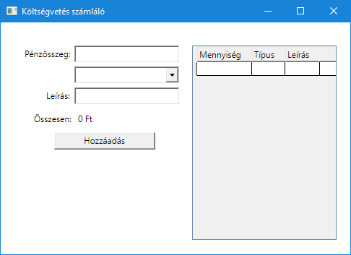
The program itself

Slide 4
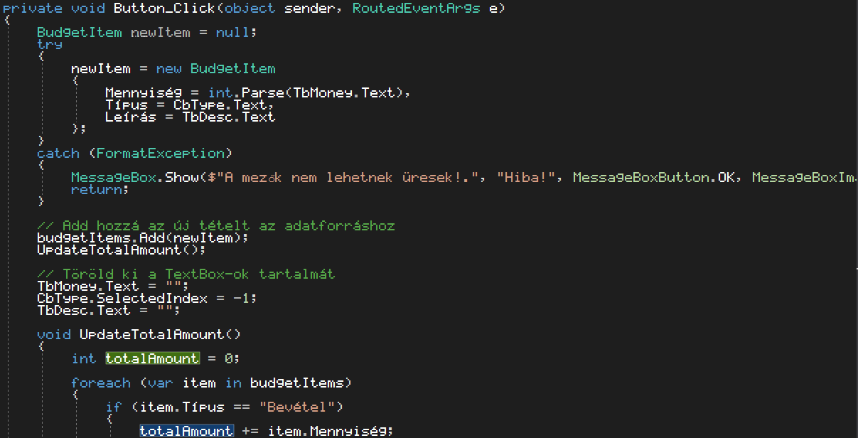
The code

Slide 5
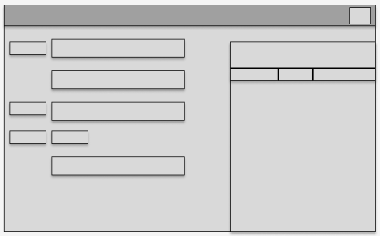
The prototype

Slide 6
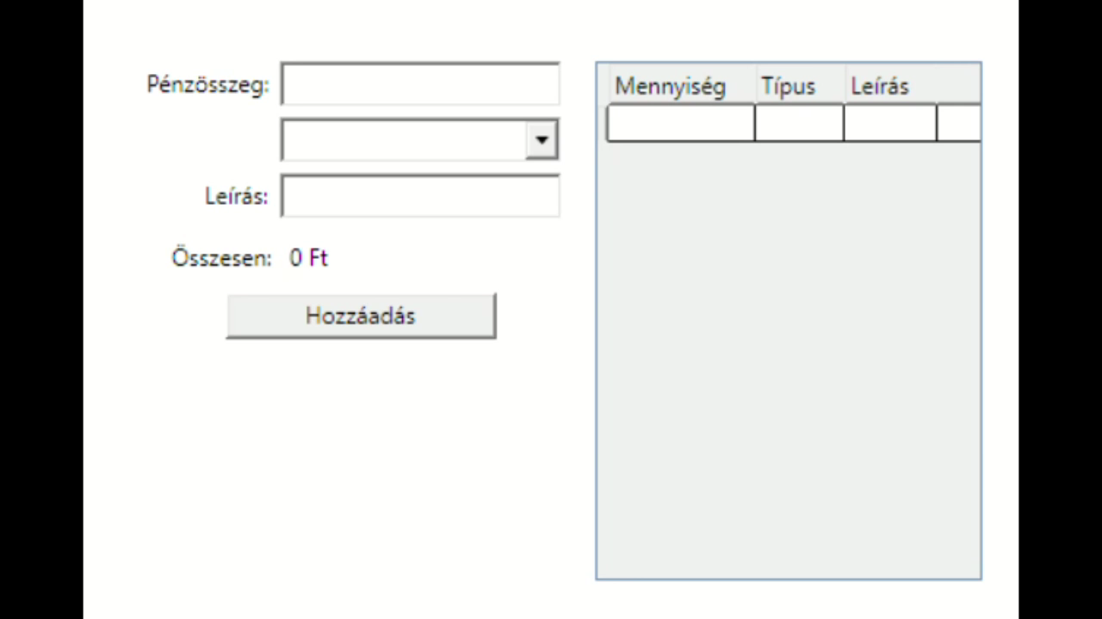
Video Demo

Slide 7
Thanks for listening!
:3

